Slide 1
America Saves Panel
SAVING AT ANY AGE

Slide 2
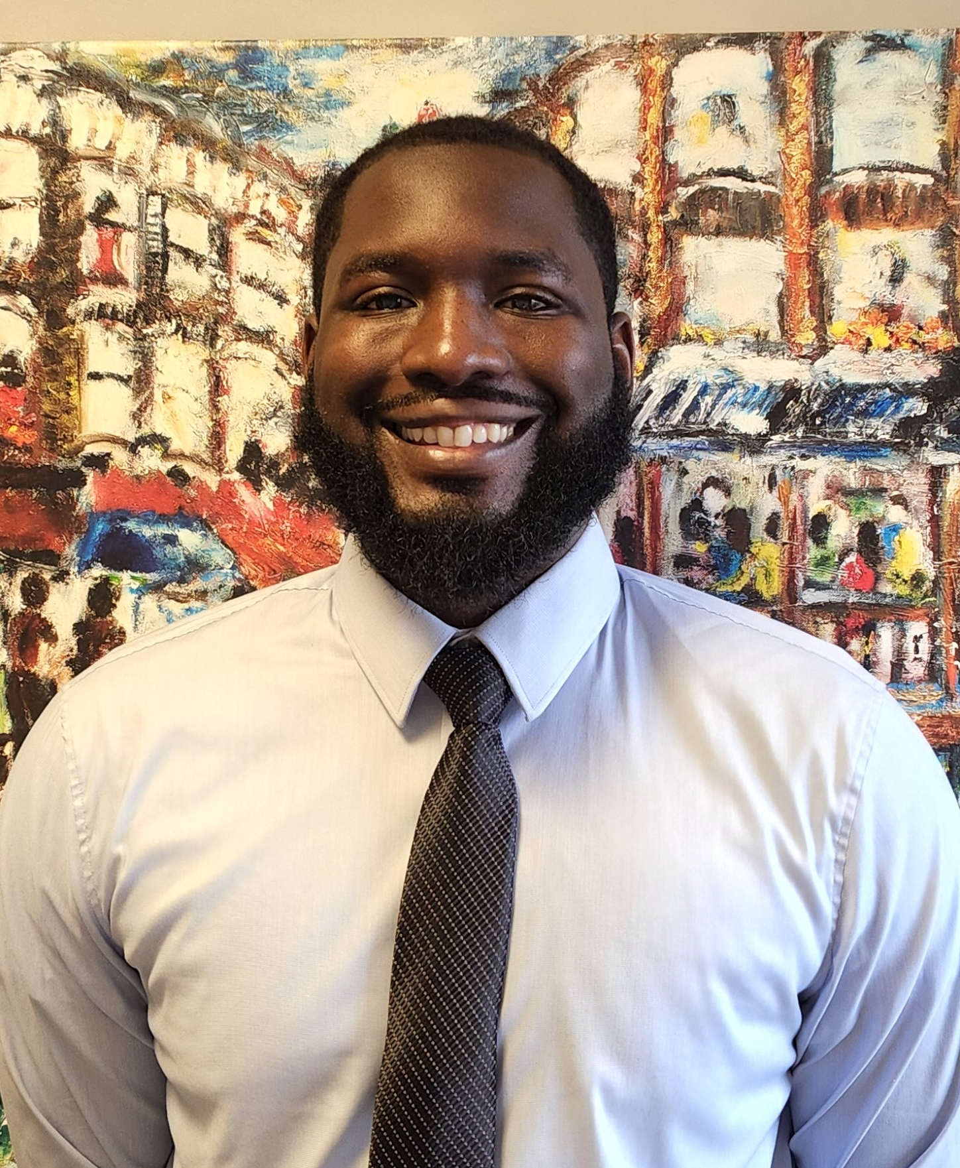
Meet the Hosts
Terrence Bazile
Community Engagement Specialist
Dominique Verdieu
Community Engagement Specialist

Slide 3
Today’s Webinar
Reducing Background Noise
We’ve muted all attendees to help with audio quality.
Using the “Q&A” Feature
Submit questions at any point.
Presentation Recording
This presentation is being recorded and will be posted on our YouTube channel (@myHUECU) to re-watch.
Post-Workshop Survey
Take our post-workshop survey and let us know how we did.

Slide 4
Not-For-Profit Banking for the Harvard Community
Community Focused
Products & Services
Access Anywhere
HUECU exclusively serves the Harvard community and all Harvard affiliates. Once a member, always a member, even if you leave your job. When you join membership extends to all family members.
Free access to ATMs nationwide. Credit cards with cash back rewards. Home loans for purchases and refinancing, student loans and refinancing options, auto loans and more.
Convenient locations and Online Banking. Mobile Banking and Digital Wallet ready. Access to the nationwide CO-OP Shared Branching Network.

Slide 5
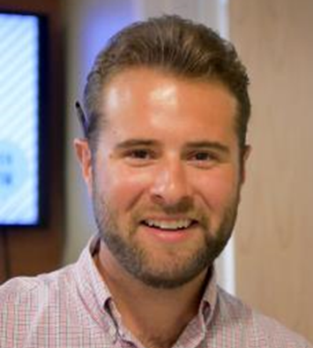
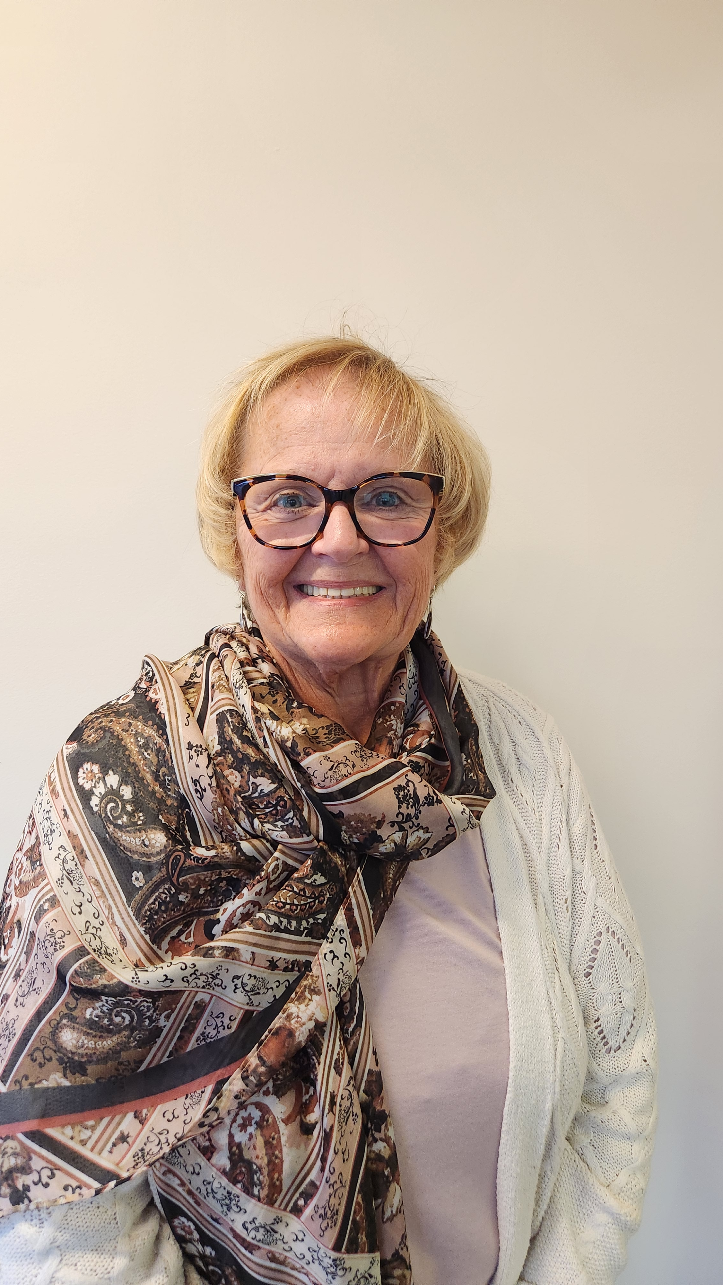
Meet the Panelists
Jawahir
Student Advisory Council Representative
Ryan Duckless
Mortgage Loan Originator
Marilyn
Training Specialist

Slide 6
How much should I have in savings in my early-career days?
Question?
Notes:
Jawahir

Slide 7
How much should I save for a healthy retirement?
Notes:
Ryan/Marilyn

Slide 8
If I’m a mid-career, what are some saving tips?
Question?
Notes:
Ryan

Slide 9
Is having a savings account enough? What are my other options?

Slide 10
I’m 70 and just started saving. What should I do?
Question?

Slide 11
How to balance short, medium, and long-term savings priorities?
Question?

Slide 12
How to save for college expenses? As parents and students?

Slide 13
What savings mistakes have you made along the way and what lessons have you learned?
Question?

Slide 14
I am a student with a small income. What is the smartest thing to do with what I save?

Slide 15
I am a student with a small income. What is the smartest thing to do with what I save?
Question?

Slide 16
What are some saving strategies when you are on a tight budget?

Slide 17
Question?
How can I save for big purchases such as a home or car?

Slide 18
What are some savings strategies for people in their early twenties?

Slide 19
Time for Live Questions
Please submit your question using the Q&A feature

Slide 21
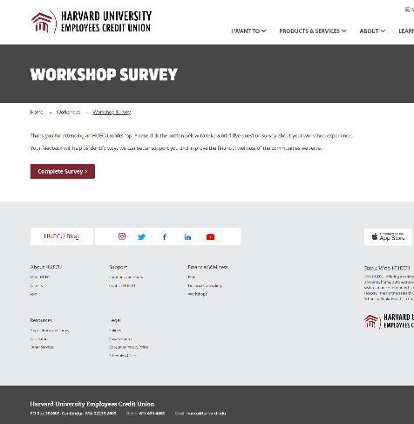
Survey Says
Be sure to let us know what you thought
of this webinar in our online survey.
HUECU.ORG/SURVEY

Slide 22
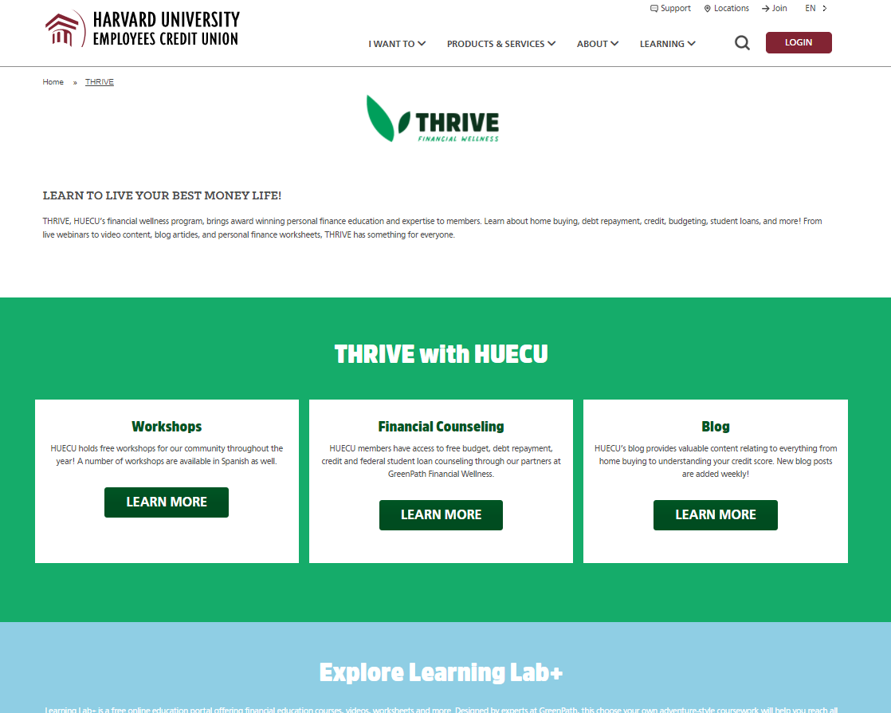
THRIVE Financial Wellness
Free Financial Counseling, Blogs, Workshops, Worksheets, Short Videos, Calculators and online education portal.
HUECU.ORG/THRIVE

Slide 23
Disclaimer
This presentation is a general overview of principles you may want to consider. Only you can decide what is best for you. This presentation is educational in nature and is not intended to be, and should not be construed as tax, legal or investment advice. You should always consult a certified advisor for advice on your specific situation. The examples used in this presentation are for illustrative purposes only.
Notes:
Does this work for the below slide?

Slide 24
Keep in Touch
huecu@harvard.edu
huecu.org
@myHUECU
Find us on all social channels
104 Mount Auburn Street
Cambridge, MA 02138

