Slide 1
Debt Repayment Strategies

Slide 2
Today’s Webinar
Reducing Background Noise
We’ve muted all attendees to help with audio quality.
Using the “Questions” Feature
Submit questions at any point. Let’s test it!
Presentation & Recording
This presentation is being recorded and will be posted on our YouTube channel to re-watch.

Slide 3
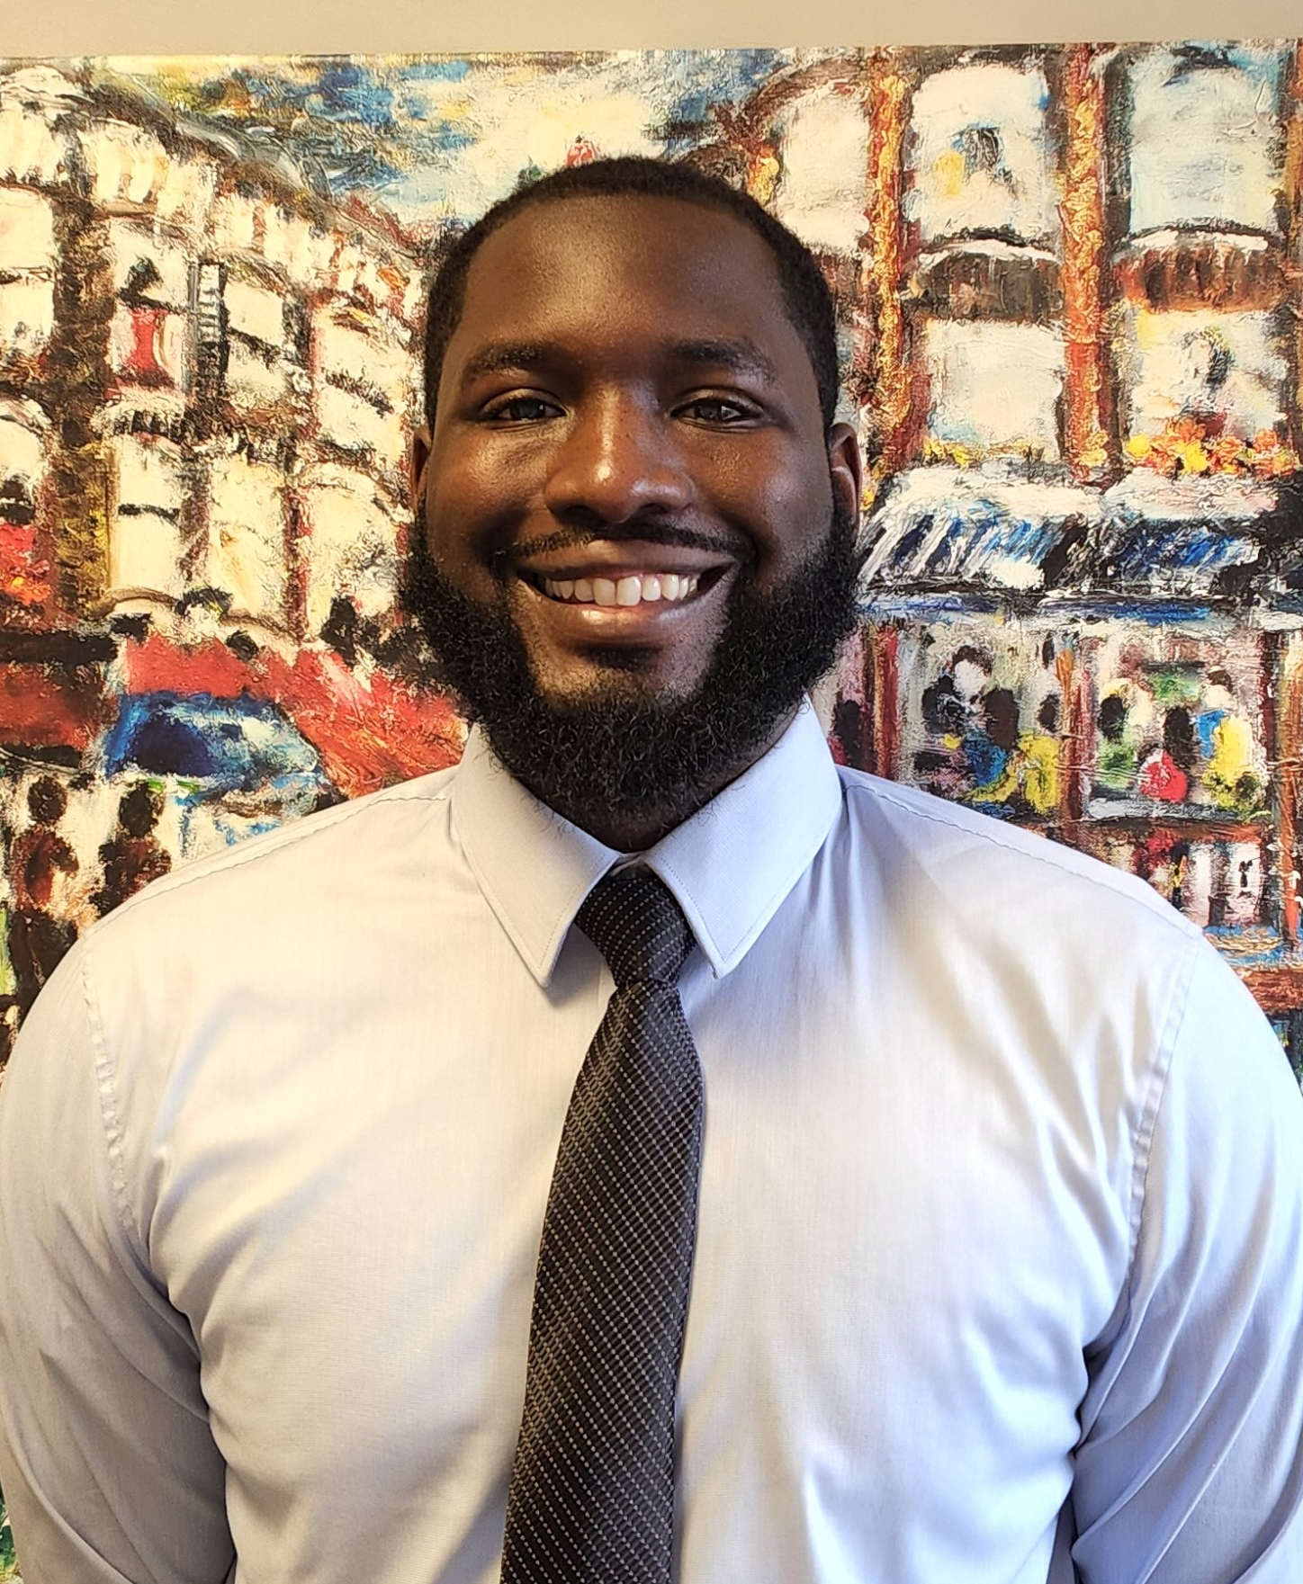
Meet the Hosts
Terrence Bazile
Community Engagement Specialist
Dominique Verdieu
Community Engagement Specialist

Slide 4
Meet the Hosts
Migdalia Gomez
AVP, Community Engagement
Terrence Bazile
Community Engagement Specialist
Dominique Verdieu
Community Engagement Specialist

Slide 5
The Credit Union Difference
Better Value
As a not-for-profit, HUECU puts members first in the form of better rates on savings and loans, lower & fewer fees, and more free services and perks.
Better Service
Credit unions consistently outperform banks in metrics of customer service and satisfaction. You have a name not just an account number here.
Better Business Model
The member controlled co-op model is always focused on operating in the best interests of our members.
Better For the Community
Your money stays local when you bank with HUECU. We give back to our community by offering financial education programs and support for local charitable organizations.

Slide 6
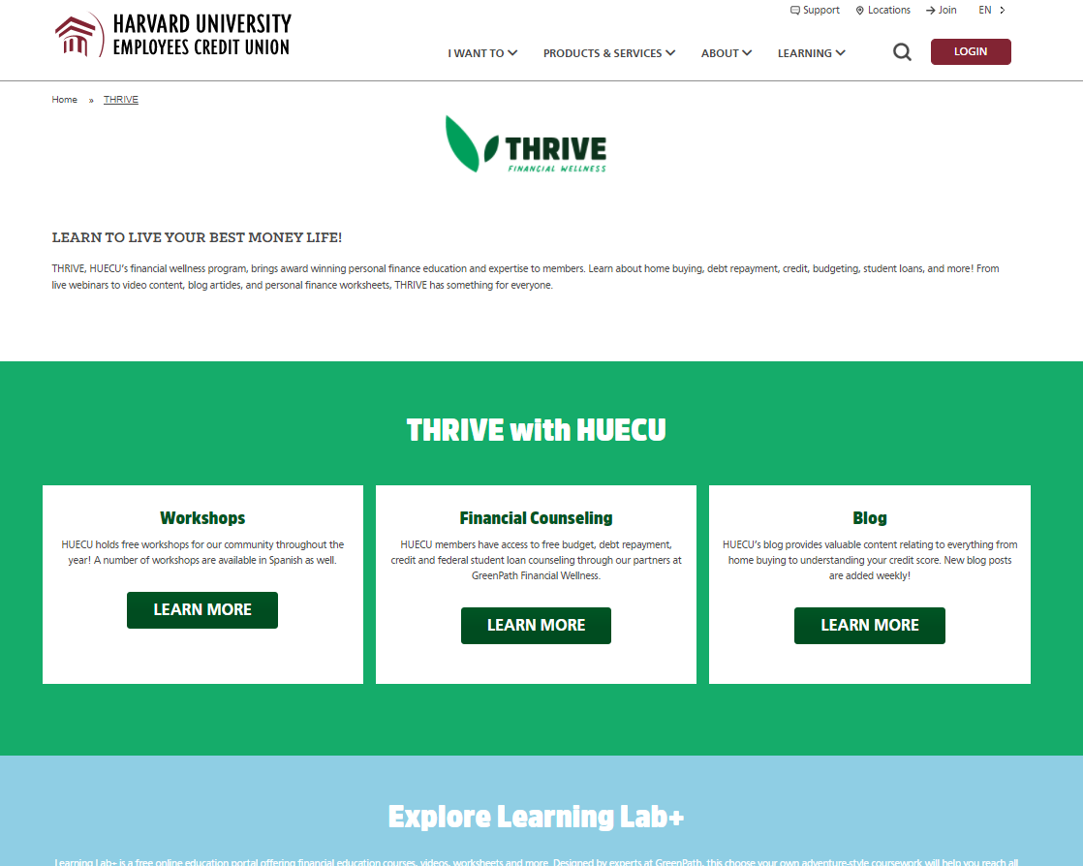
THRIVE Financial Wellness
Free Financial Counseling, Blogs, Workshops, Worksheets, Short Videos, Calculators, and an online education portal.
HUECU.ORG/THRIVE
Notes:
I would suggest moving this to the end of the show

Slide 10
STEP 1
What Are Your Goals?

Slide 11
Notes:
Aligning priorities image
Greenpath-

Slide 12
You Are Here
WHAT DO YOU OWE?
WHAT’S YOUR CREDIT SCORE?
CALCULATING COST OF DEBT

Slide 13
Calculating the Cost of Your Debt
AMOUNT | APR | TERMS | MONTHLY PAYMENT | TOTAL INTEREST PAID
$10,000 | 7.5% | 120 MONTHS | $119 | $4,244
$5,000 | 18.0% | 60 MONTHS | $127 | $2,618
TOTAL AMOUNT | MONTHLY PAYMENT | TOTAL INTEREST
$15,000 | $246 | $6,862
Notes:
In the original chart there were some cells that were in red, (120 years, $552, 89 years, $575, 84 years)

Slide 14
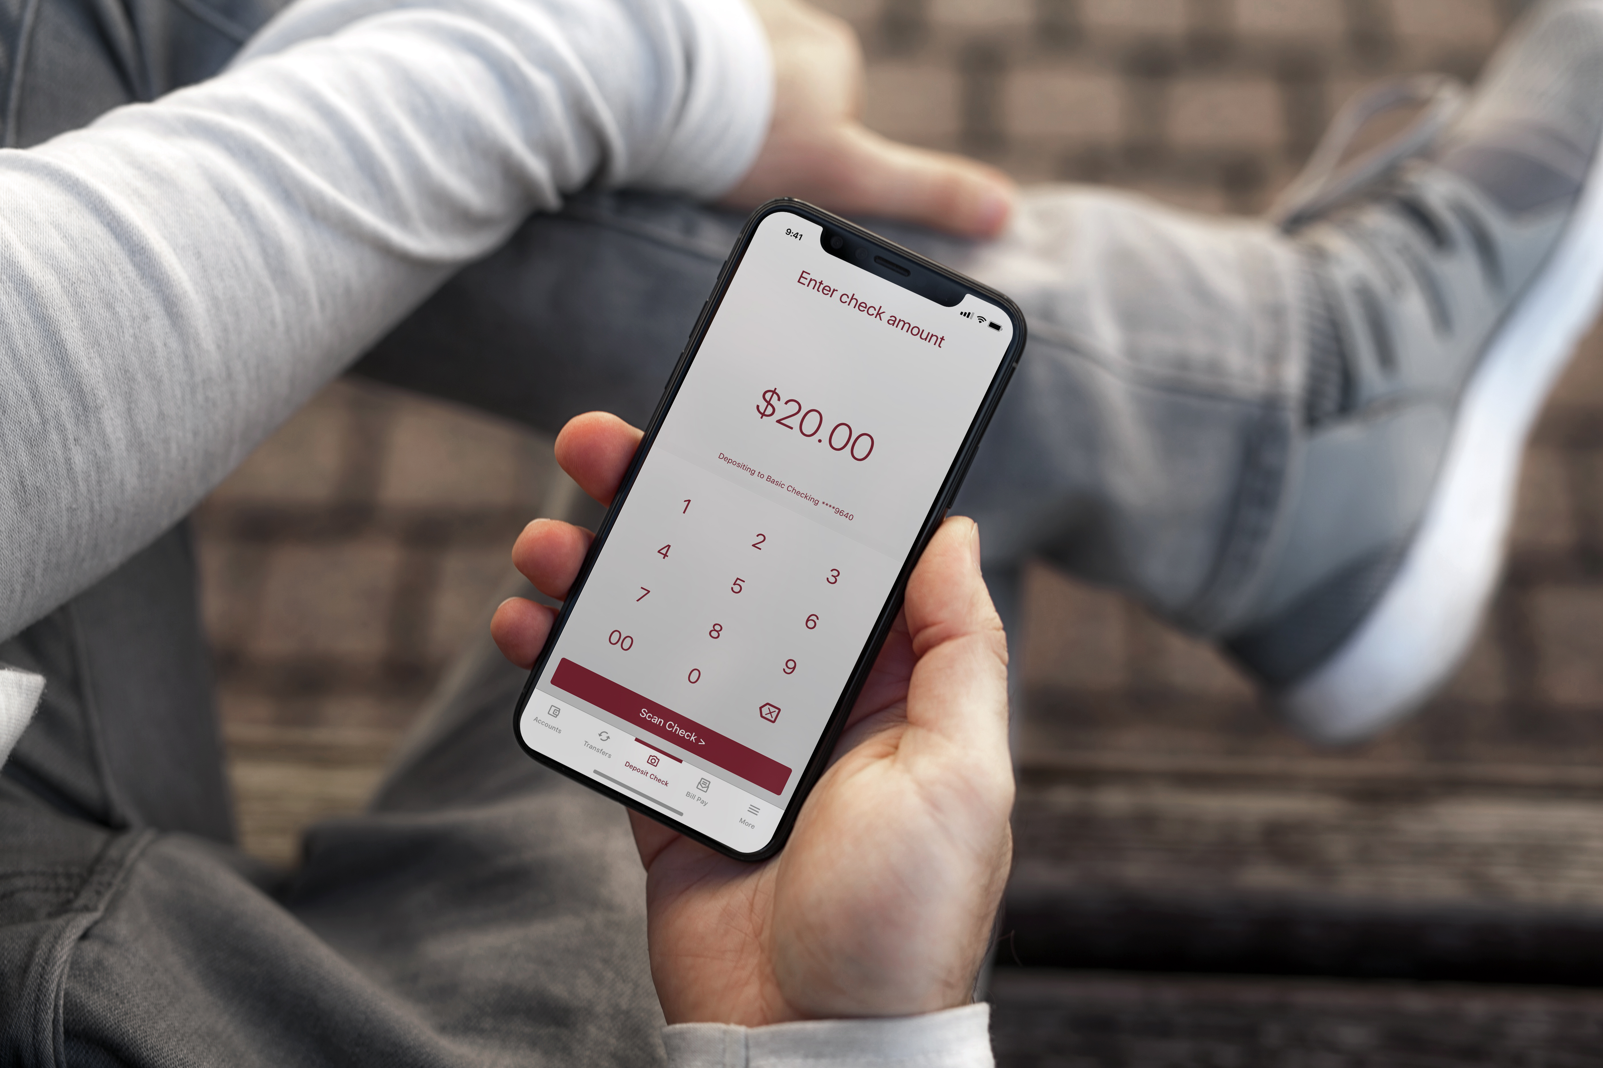
Emergency
Fund
CALCULATE
3 months of expenses
6 months of expenses
START SMALL & BUILD
$50
$250

Slide 15
STEP 2
Debt Repayment Strategies

Slide 16
Snowball and Avalanche Methods
SNOWBALL
AVALANCHE
Focuses on smallest amount of debt.
Focuses on highest interest.
Make minimum payments on each debt monthly
Make minimum payments on each debt monthly
Make extra payments on the smallest loan
Make extra payments on the highest interest rate loan
When paid off, move to the next smallest loan debt
When paid off, move to the next debt with the highest interest rate.

Slide 17
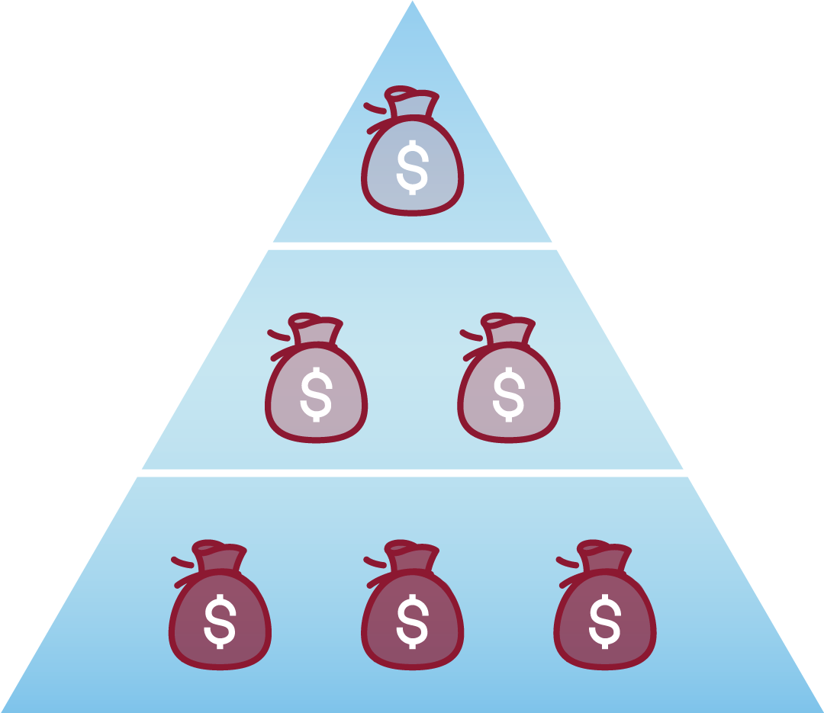
START HERE
DEBT SNOWBALL
Focuses on the smallest amount of debt.
SMALL DEBT
MEDIUM DEBT
LARGE DEBT
DEBT AVALANCHE
START HERE
Focuses on highest interest rate.

Slide 18
A Little Goes a Long Way
$10,000 LOAN AT 7%
MONTHLY PAYMENT | TOTAL INTEREST PAID | TERMS
$200 | $1,858 | 60
$225 | $1,609 | 52
$250 | $1,421 | 46
Notes:
In the original chart there were some cells that were in red, (120 years, $552, 89 years, $575, 84 years)

Slide 19
STEP 3
Know Your Options

Slide 20
Talk With Lender
Speak with Decision Maker
Propose New Payment
Explain your situation to determine whom can best help you.
Calculate how much you can pay and discuss repayment options with your lender
Ask About
Have a Paper Trail
Interest Rate Reduction, Loan Deferment, Loan Forbearances, Loan Extension and Consolidation
Keep notes on your conversations, including names of those you spoke with.
Notes:
Animate is click for each step

Slide 21
What is Refinancing?
A new loan that pays off your previous loan.
BENEFITS OF REFINANCING
Lower interest rate.
Extended loan terms, leading to lower monthly payment.
Typically, no application fee and no prepayment penalties.
Notes:
Animate is click for each step

Slide 22
Benefits of Refinancing
$10,000 LOAN WITH $200 PAYMENTS FOR 60 MONTHS
INTEREST RATE | MONTHLY PAYMENT | TOTAL INTEREST PAID | TERMS
7% | $200 | $1,858 | 60
5% | $189 | $1,323* | 60
5% | $200 | $1,237* | 57
*Does not include prior interest paid on original loan.
Notes:
In the original chart there were some cells that were in red, (120 years, $552, 89 years, $575, 84 years)

Slide 23
What to Consider Before Refinancing
*Some lenders offer interest rate discounts for automatic loan payments.
Interest Rate
Benefits
Credit Score
Compare interest rate, and whether it is fixed, variable or hybrid.
May lose benefits associated with original loans.
A higher credit score may mean lower interest rate.
Notes:
Animate is click for each step

Slide 24
Look for Lower Rates
Personal Loans
Refinancing Loans
Mortgage Refinancing
Auto Refinancing
Student Loan Refinancing
Debt Consolidation Loans
Credit Card Balance Transfers

Slide 25
GreenPath
GreenPath Financial Wellness offers free credit, budget and, Federal Student Loan counseling.
HUECU.ORG/GREENPATH

Slide 26
Debt Management Plan
Reduces interest rates on debts
Provides financial counseling
Cost based off state ($75 max monthly in MA)
Debt Management Plans are NOT the same as Debt Settlement

Slide 27
Debt Management Plan By The Numbers
An example of GreenPath Financial Wellness’ program. Member is estimated to payoff unsecured debts 40 months sooner and save $31,960
 | CURRENTLY | ON GP PROGRAM | YOUR BENEFITS
INTEREST CHARGES | $573.13 | $234.22 | $338.91
LATE/OVERLIMIT CHARGES | $150 | $30.00 | $120.00
SERVICE FEE | $0.00 | $50.00 | ($50.00)
PRINCIPLE PAYMENT | $75.87 | $484.76 | $408.91
Notes:
In the original chart there were some cells that were in red, (120 years, $552, 89 years, $575, 84 years)

Slide 28
Next Steps
STAY MOTIVATED
STAY INFORMED
TAKE ACTION
WHAT WILL YOU DO?
Today
This week
This month

Slide 29
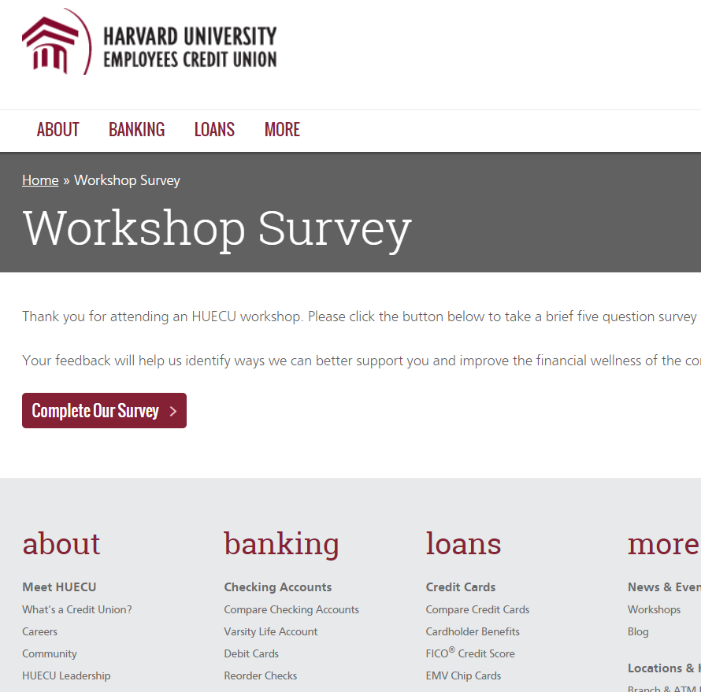
Survey Says
Be sure to let us know what you thought
of this webinar in our online survey.
HUECU.ORG/SURVEY

Slide 30
Disclaimer
This presentation is a general overview of principles you may want to consider. Only you can decide what is best for you. This presentation is educational in nature and is not intended to be, and should not be construed as tax, legal or investment advice. You should always consult a certified advisor for advice on your specific situation. The examples used in this presentation are for illustrative purposes only.
Notes:
Does this work for the below slide?

Slide 33
Keep in Touch
huecu@harvard.edu
huecu.org
@myHUECU
Find us on all social channels
104 Mount Auburn Street
Cambridge, MA 02138

